Slide 1
Chapter 5
Difficult Cases for the Market and the Role of Government

Slide 2
A Closer Look at Economic Efficiency

Slide 3
What is Economic Efficiency?
Economists use the concept of efficiency to judge actions because efficient use of resources implies the maximum value of output from the resource base.
All activities that provide individuals with more benefits than costs must be undertaken.
In order for economic efficiency to be achieved, both conditions must be present.
Two conditions necessary for ideal efficiency:
No activities that provide benefits less than costs should be undertaken.
Notes:
Economists acknowledge that individuals generally do not regard the efficiency of the entire economy as a primary goal for themselves. Rather, each person is interested in enlarging the size of his or her own slice. But if resources are used more efficiently, the overall size of the pie will be larger, and therefore, at least potentially, everyone could have a larger slice. For an outcome to be consistent with ideal economic efficiency, two conditions are necessary.
Economic efficiency results only when both of these conditions have been met. Either failure to undertake an efficient action (Rule 1) or the undertaking of an inefficient action (Rule 2) will result in economic inefficiency.

Slide 4
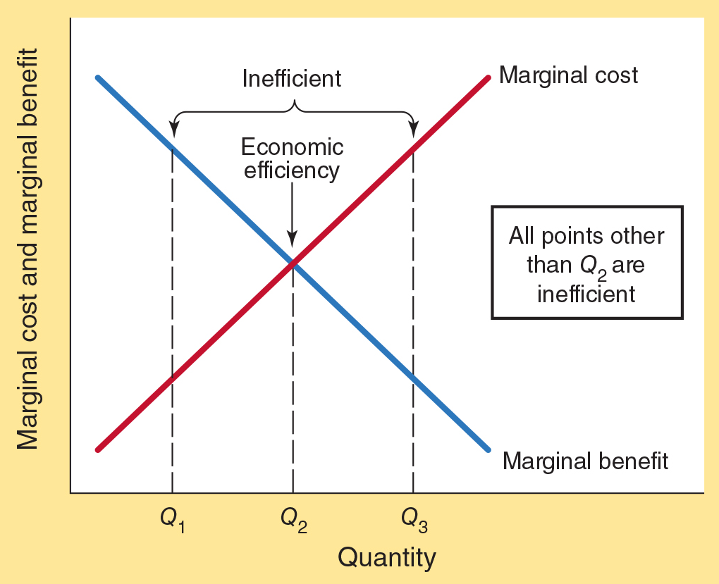
Economic Efficiency
As more resources are used to expand the level of an activity, the marginal benefits (MB) of the activity generally decline and marginal costs (MC) rise.
From the viewpoint of efficiency, the activity should be expanded as long as the MB > MC.
Q₁ is inefficient as there are some units for which the MB exceeds the MC which are not undertaken.
Q₃ is also inefficient as there are units produced where the MC exceeds the MB.
Q₂ is the economically efficient level of output. At Q₂ the MB stemming from the consumption of that unit just equals the MC of producing it.

Slide 5
If It’s Worth Doing,
It’s Worth Doing Imperfectly

Slide 6
If It’s Worth Doing, It’s Worth Doing Imperfectly
There is an old saying, “If it’s worth doing, it’s worth doing to the best of your ability.” Is this really true?
Economics indicates that at some point the gains from doing something better will not be worth the cost.
Economics is about trade-offs:
Even worthy activities can be pursued beyond the level consistent with economic efficiency.
It makes sense to stop short of perfection.
Notes:
Eliminating pollution. Earning straight As. Being completely organized. Cleaning your apartment until it sparkles. Making automobiles completely safe. Making airplanes fully secure against terrorist attacks. All of these are worthwhile goals, right? Well, they are until you consider the costs of actually achieving them. The heading for this section is, of course, a play on the old saying “If it’s worth doing, it’s worth doing to the best of your ability.” Economics suggests, however, that this is not a sensible guideline. At some point, the gains from doing something even better will not be worth the cost. It will make more sense to stop short of perfection.

Slide 7
If It’s Worth Doing, It’s Worth Doing Imperfectly
When making personal decisions, people seem to be more aware that perfection is almost never worth the cost.
The principle also applies to government.
Regardless of the sector, achievement of perfection is generally not worth the cost.
Notes:
If we want to get the most out of our resources, we need to think about both marginal benefits and marginal costs and recognize that there are alternative ways of pursuing objectives. Consequently, economists do not ask whether eliminating pollution or saving lives is worth the cost in terms of dollars per se, but whether it is worth the cost in terms of giving up other things that could have been done with those dollars—the opportunity cost. Spending an extra $10 billion on school safety requirements to save 50 lives isn’t efficient if the funds could have been spent differently and saved the lives of 500 children. It is no more efficient for the government to pursue perfection than for individuals to do so.

Slide 8
Thinking About the
Economic Role of Government

Slide 9
Two Major Functions of Government
There is substantial agreement among scholars that at least two functions of government are legitimate:
Protective function:
protection of individuals and their property against invasions by others.
Productive function:
the production of goods and services that cannot easily be provided through private markets.
Notes:
For centuries, philosophers, economists, and other scholars have debated the proper role of government. While the debate continues, there is substantial agreement that at least two functions of government are legitimate: (1) protecting individuals and their property against invasions by others and (2) providing goods that cannot easily be provided through private markets. These two functions correspond to what Nobel laureate James M. Buchanan conceptualizes as the protective and productive functions of government.

Slide 10
Protective Function of Government
The most fundamental function of government is the protection of individuals and their property against acts of aggression.
Involves the maintenance of a legal structure (rules) for the enforcement of contracts and a mechanism for the settlement of disputes.
Notes:
The most fundamental function of government is the protection of individuals and their property against acts of aggression. As John Locke wrote more than three centuries ago, individuals are constantly threatened by “the invasions of others.” Therefore, each individual “is willing to join in society with others, who are already united, or have a mind to unite, for the mutual preservation of their lives, liberties, and estates.”
The protective function of government involves the maintenance of a framework of security and order—an infrastructure of rules within which people can interact peacefully with one another. Protection of person and property is crucial. It entails providing police protection and prosecuting aggressors who take things that do not belong to them. It also involves providing for a national defense designed to protect against foreign invasions. The legal enforcement of contracts and rules against fraud are also central elements of the protective function. People and businesses that write bad checks, violate contracts, or knowingly supply others with false information, for example, are therefore subject to legal prosecution.
When people are assured that they will be able to enjoy the benefits of their efforts, they will be more productive. In contrast, when property rights are insecure and contracts unenforceable, productive behavior is undermined. Plunder, fraud, and economic chaos result. Governments set and enforce the “rules of the game” that enable markets to operate smoothly.

Slide 11
Productive Function of Government
Involves the provision of a limited set of goods difficult to supply through the market.
A stable monetary and financial environment is vital.
Notes:
The nature of some goods makes them difficult to provide through markets. Sometimes it is difficult to establish a one-to-one link between the payment and receipt of a good. If this link cannot be established, the incentive of market producers to supply these goods is weak. In addition, high transaction costs—particularly, the cost of monitoring use and collecting fees—can sometimes make it difficult to supply a good through the market. When either of these conditions is present, it may be more efficient for the government to supply the good and impose taxes on its citizens to cover the cost.

Slide 12
Questions for Thought:
1. From the standpoint of economic efficiency, which of the following make sense:
(a) Make the highest possible grade in your economics class.
(b) Eliminate all air and water pollution.
(c) Make airplanes fully secure against terrorist attacks.
(d) Make cars so safe there will never be another traffic fatality.

Slide 13
Questions for Thought:
2. What is the distinction between the “protective” and “productive” functions of government?
3. “If it’s worth doing, it’s worth doing to the best of your ability.” What is the economic explanation for why this statement is often said but rarely done?

Slide 14
Potential Shortcomings of the Market

Slide 15
Four Reasons the Invisible Hand May Fail
Four Reasons
Lack of Competition
“The principal justification for public policy intervention lies in the frequent and numerous shortcomings of market outcomes.”
––Charles Wolf, Jr. senior economic advisor
at the RAND Corporation
Externalities
Public Goods
Poor Information

Slide 16
Why the Invisible Hand May Fail:
(1) Lack of Competition
When competition is absent:
Sellers may gain by restricting output and raising price.
Too few units will be produced.
Notes:
Competition is vital to the proper operation of the pricing mechanism. The existence of competing buyers and sellers reduces the power of both to rig or alter the market in their own favor. Although competition is beneficial from a social point of view, individually each of us would prefer to be loosened from its grip.
Students do not like stiff competitors in their romantic lives, at exam time, or when they’re trying to get into graduate school. Buyers in online auctions hope for few competing bidders so they can purchase the items they’re bidding on at lower prices. Similarly, sellers prefer fewer competing sellers so they can sell at higher prices. This is precisely why taxi companies are quick to protest and seek bans against ride-sharing services like Uber and Lyft when they come to an area.

Slide 17
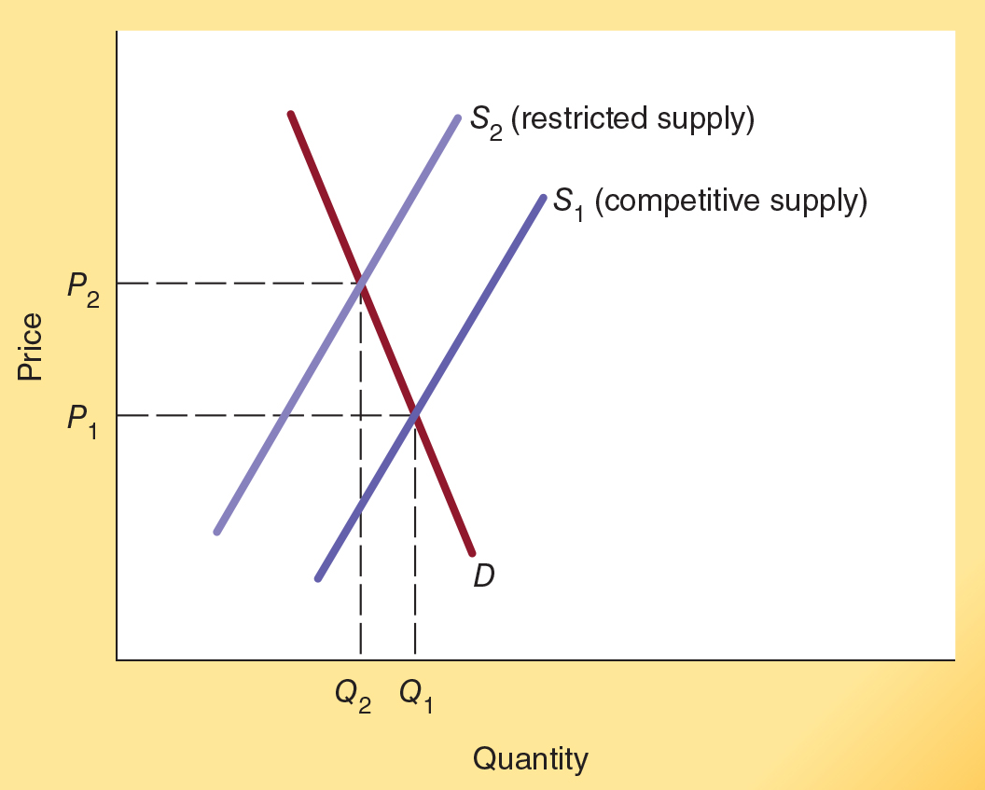
Lack of Competition: Sellers may gain by restricting output and raising price.
In this market, under competitive conditions, supply and demand result in an output of Q₁ and price P₁.
But, if producers in the market are able to restrict supply and/or limit entry into the market then the restricted supply S₂ will result, with an output of Q₂ < Q₁ and price of P₂ > P₁.
When competition is absent, too few units are produced and the price is higher than the competitive market level.

Slide 18
Why the Invisible Hand May Fail:
(2) Externalities
Externalities exist when the market fails to register fully costs and benefits.
External costs:
Present when the actions of individuals, group, or firms harm the property of others without their consent.
External benefits:
Present when the actions of individuals, groups, or firms generate benefits for nonparticipating parties.
The problem arises because property rights are imperfectly defined and/or enforced.
Notes:
When property rights are unclear or poorly enforced, the actions of an individual or group may “spill over” onto others and thereby affect their well-being without their consent. These spillover effects are called externalities.
You are probably familiar with externalities. For example, when your neighbor’s loud stereo makes it hard for you to study, you are experiencing an externality firsthand. Although your neighbors do not have a right to come in to your apartment and create a disturbance, they do have a right to listen to their stereo, and if they play it loudly, this may interfere with the quietness of your apartment. Their actions impose a cost on you, and they also raise an issue of property rights.
Do your neighbors have a property right to play their stereo as loudly as they please? Or do you have a property right to quietness in your own apartment? When questions like these arise, how should the boundaries of property rights be determined, and what steps should be taken to ensure adequate enforcement? Although the volume of your neighbor’s stereo may not be a major economic issue, it nonetheless illustrates the nature of the problems that arise when property rights are unclear and externalities are present.

Slide 19

Problems that Arise when
External Costs are Present
Because some of the costs of production are not fully registered when external costs are present, the supply curve understates the true cost of production.
This is inefficient because units will be produced that are valued less than their full cost.
Can you explain the link between external costs and pollution?
Notes:
Economists worry about external costs because they may result in economic inefficiency. For example, resources may be used to produce goods that are valued less than their production costs, including the costs imposed on the nonconsenting parties.
Consider the production of paper. The firms in the market operate mills and purchase labor, trees, and other resources to produce the paper. But they also emit pollutants into the atmosphere that impose costs on residents living around the mills. The pollutants cause paint on buildings to deteriorate more rapidly. They make it difficult for some people to breathe normally, and perhaps cause other health hazards. If the residents living near a pulp mill can prove they have been harmed, they could take the mill to court and force the paper producer to cover the cost of their damages. But it might be difficult to prove that they were harmed and that the pulp mill is responsible for the damage. As you can see, the residents’ property rights to clean air may be difficult to enforce, particularly if there are many parties emitting pollutants into the air.

Slide 20
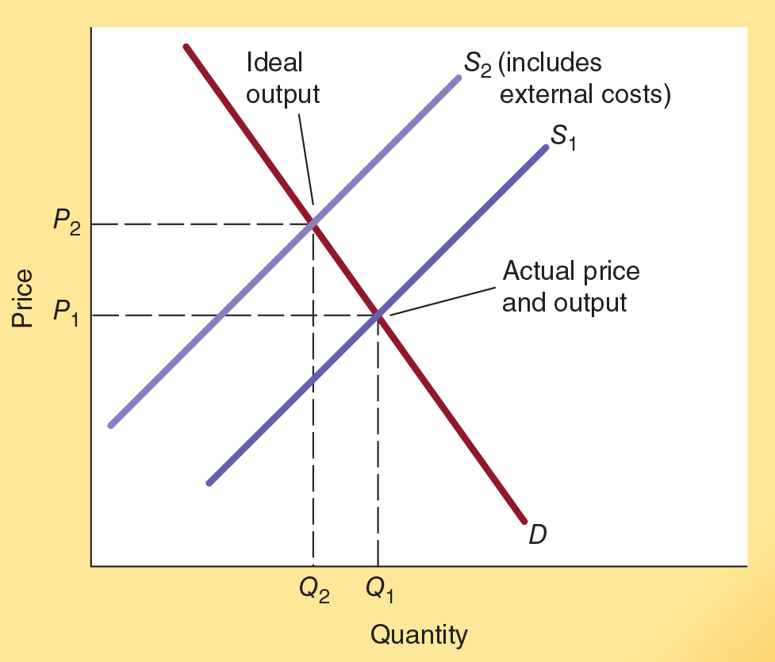
External Costs: Failure to fully register external costs
In this market, under initial supply and demand conditions, output Q₁ and price P₁ exist.
If all economic costs were measured and included the supply curve S₂ would result in output Q₂ < Q₁ and price P₂ > P₁.
With external costs (a negative externality) too many units are produced and price is below that which would prevail if all costs were identified and factored into the market process.

Slide 21

Outstanding Economist: Elinor Ostrom
• In 2009, Elinor Ostrom became the first woman to earn the Nobel Prize in Economics, an award she shared with Oliver Williamson. She was awarded the Nobel Prize for her research on the “tragedy of the commons”—the idea that when a resource is owned in common it will be overused because each person has an incentive to use it before others do.
• Ostrom’s research found that community management and rulemaking was often superior to top-down central planning by governmental authorities. Her work provides insight on how cooperative arrangements can sometime lead to efficient solutions even when a resource is owned in common.
JOHN SOMMERS II/REUTERS/Newscom
Notes:
Ostrom had a lengthy career as a distinguished professor and director of the Workshop in Political Theory and Policy Analysis at Indiana University. Ostrom examined numerous real-world cases and discovered that communities were often able to develop rules for the successful private management of common-pool resources. If the rules were going to work well, they must clearly define who gets what, provide for conflict resolution, and assign the duty of individuals to maintain the resource in proportion to the benefits received.

Slide 22
Problems that Arise when
External Benefits are Present
When external benefits are present, the demand curve understates the total value of the output.
Units that are more highly valued than their costs may not be produced.
From the viewpoint of efficiency, too few units will often be produced.
Notes:
Sometimes the actions of individuals and firms generate external benefits for others. The homeowner who keeps a house in good condition and maintains a neat lawn improves the beauty of the entire community.
From the standpoint of efficiency, why might external benefits be a problem? Here, inefficiency may arise because potential producers may fail to undertake productive activities because they are unable to fully capture the benefits their actions create for others.

Slide 23
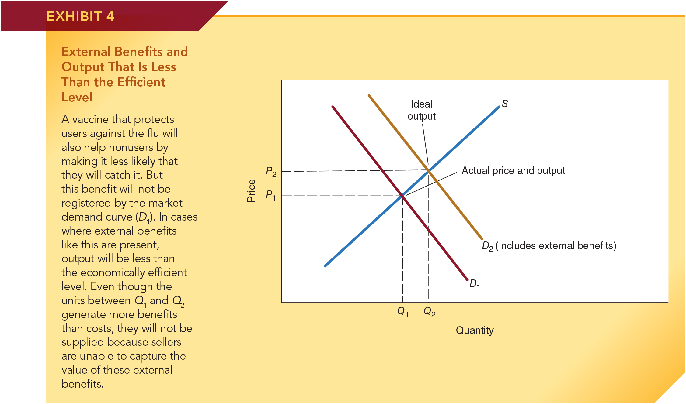
External Benefits: Failure to fully register external benefits
In this market, under present supply and demand conditions, output Q₁ and price P₁ exist.
If all benefits were measured and included, the new demand curve D₂ would result in output Q₂ > Q₁ and price P₂ > P₁.
When external benefits (a positive externality) are present, too few units will often be produced and price will be less than that which would prevail if all the benefits were identified and reflected in the market process.

Slide 24
Market Efforts to Capture External Benefits
Entrepreneurs have a strong incentive to figure out ways to capture external benefits.
Sometimes, they are able to capture what would otherwise be external benefits by extending the scope of the firm.
Can you explain why the Disney corporation purchased far more land than needed for its amusement parks when it developed Disney World in Florida?
Notes:
External benefits result in a misallocation of resources if entrepreneurs fail to undertake potentially wealth-creating projects because of their inability to fully capture the benefits of their actions. However, when entrepreneurs can figure out a way to more fully capture these benefits, some otherwise unprofitable projects can be transformed into profitable ones. Entrepreneurs have an incentive to figure out ways to do this. In some cases, they can do so by extending the scope of the project.

Slide 25
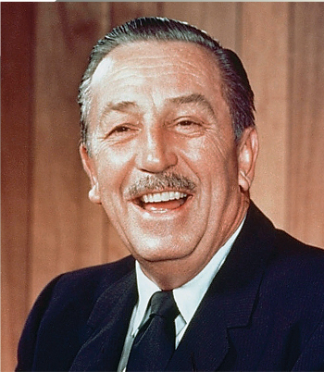
Entrepreneurs Who have
Changed Our Lives: Walt Disney
• Most of Disney’s achievements were in film, particularly animated movies. He created iconic cartoon figures such as Mickey Mouse, Donald Duck, and Goofy.
• In 1937, in the depths of the Great Depression, Disney’s first full-length animated film, Snow White and the Seven Dwarfs, earned nearly $1.5 million at the box office and won eight Academy Awards. Animated features such as Bambi and Fantasia followed.
• In 1955 he opened Disneyland, in Anaheim, and a decade later began the planning for Disney World in Florida. It was his idea to purchase far more land than would be necessary for the park—something they failed to do with Disneyland—so that the Disney Corporation could capture the appreciation of land values around Disney World.
HO Images/Alamy
Notes:
Born in Chicago in 1901, Disney was the son of a struggling businessman. His family—Walt, his parents, and three siblings—moved around the Midwest, as his father tried one business after another, and most failed. As a child, Disney loved to draw cartoons, to listen to his mother tell fairy tales, and to read the books of Charles Dickens and Mark Twain.
His love of fantasy and fiction served him well over time. Disney, along with his brother Roy and a friend, Ubbe Iwerks, began to develop animated cartoon movies in Kansas City. They moved to Los Angeles when the animated film industry was still in its early stages of development.
As television became popular in the 1950s, Disney created such popular programs as Zorro, Davy Crockett, and The Mickey Mouse Club. And in 1955 he opened the most exciting amusement park of its time, Disneyland, in Anaheim, California. Disney’s restless mind, supported by his brother and a friend, created joy for generations of children—and adults, too.

Slide 26
Why the Invisible Hand May Fail:
(3) Public Goods
Public goods are:
Jointly consumed
Individuals can simultaneously enjoy consumption of the same product or service.
Non-excludable
It is costly, and in some cases, impossible to restrict the availability of the good to only those who pay for it.
Notes:
What are public goods? Public goods have two distinguishing characteristics; they are (1) nonrival in consumption and (2) nonexcludable.
Nonrivalry in consumption (jointly consumable) means that making the good available to one consumer does not reduce its availability to others. In fact, providing it to one person simultaneously makes it available to other consumers, so these goods are considered joint-in-consumption. A radio broadcast signal provides an example. The same signal can be shared by everyone within the listening range. Having additional listeners tune in does not detract from the availability of the signal.
The second characteristic of a public good—non-excludability—means that it is impossible (or at least very costly) to exclude nonpaying customers from receiving the good. Suppose an antimissile system were being built around the city in which you live. How could some people in the city be protected by the system and others excluded? Most people will realize there is no way the system can protect their neighbors from incoming missiles without providing similar protection to other residents. Thus, the services of the antimissile system have the non-excludability characteristic.

Slide 27
Problems that Arise With a Public Good
If a public good is made available to one, it is simultaneously made available to others.
Because suppliers are unable to establish a one-to-one link between payment for and receipt of the good, it will be difficult to provide public goods through markets.
Because those who do not pay can not be excluded, no one has much of an incentive to pay for such goods; each has an incentive to become a free rider.
Free rider: a person who receives the benefits of the good without helping to pay for its cost.
When a lot of people become free riders, too little of the good is produced.
Notes:
Why are public goods difficult for markets to allocate efficiently? The non-excludability characteristic provides the answer. Because those who do not pay cannot be excluded, sellers are generally unable to establish a one-to-one link between the payment and receipt of these goods.
Realizing they cannot be excluded, potential consumers have little incentive to pay for these goods. Instead, they have an incentive to become free riders, people who receive the benefits of the good without helping to pay for its cost. But, when a large number of people become free riders and revenues thus are low, not very much of the good is supplied. This is precisely the problem: Markets will tend to undersupply public goods, even when the population in aggregate values them highly relative to their cost.

Slide 28
Characteristics of a Public Good
It is the good’s characteristics, not the sector in which it is produced, that distinguishes it as a public good.
Examples of public goods:
Markets often develop ways of providing public goods.
For example: the use of advertising to support the provision of broadcast radio and television.
Nonetheless, public goods often cause a breakdown in the harmony between self-interest and the efficient use of resources.
national defense
broadcast radio and television signals
clean air
Notes:
Just because a good is a public good does not necessarily mean that markets will fail to supply it. When the benefit of producing these goods is high, entrepreneurs will attempt to find innovative ways to gain by overcoming the free-rider problem. For example, radio and television broadcasts, which have both of the public good characteristics, are still produced well by the private sector. The free-rider problem is overcome through the use of advertising (which generates indirect revenue from listeners), rather than by directly charging listeners or viewers.

Slide 29
Why the Invisible Hand May Fail:
(4) Poor Information
The consumer’s information problem is minimal if the item is purchased regularly.
Problems of conflicting interests and unhappy customers can arise if goods are:
difficult to evaluate on inspection and seldom repeatedly purchased from the same producer, or,
potentially capable of serious and lasting harmful side effects that cannot be predicted by a lay-person.
Notes:
Like other goods, information is scarce. Thus, when making purchasing decisions, people are sometimes poorly informed about the price, quality, durability, and side effects of alternative products. Imperfect knowledge is not the fault of the market. In fact, the market provides consumers with a strong incentive to acquire information. If they mistakenly purchase a “lemon,” they will suffer the consequences.
Conflicting interests, inadequate information, and unhappy customers can arise when goods are either (1) difficult to evaluate on inspection and seldom repeatedly purchased from the same producer, or (2) potentially capable of serious and lasting harmful side effects that cannot be predicted by a typical consumer. Under these conditions, consumers might make decisions they will later regret.

Slide 30
Why the Invisible Hand May Fail:
(4) Poor Information
Market responses to poor information include:
  Consumer information publications
    Provide expert evaluation and unbiased information, examples include Consumer Reports and the Better Business Bureau.
  Brand names and franchises
    Provide standardized quality and dependability
  Warranties
    Supplier promises to repair possible problems
Notes:
Consumers are willing to pay for and invest their time in acquiring information that will help them make better decisions. This presents a profit opportunity. Entrepreneurial providers of information help consumers find what they seek by offering product evaluations by experts. For example, dozens of sources provide independent expert opinions about automobiles and computers at a low cost to potential purchasers. Laboratory test results and detailed product evaluations on a wide variety of goods are provided by firms such as Consumer Reports and J.D. Power.

Slide 31
Market and Government Failure

Slide 32
Market Failure
Market failure is the term used to describe the failure of markets to achieve the ideal conditions of economic efficiency.
When markets allocate goods inefficiently, the problem can generally be traced back to the absence of competition, externalities, public goods, or poor information.
Notes:
A lack of competition, externalities, public goods, and information problems often pose challenges and sometimes undermine the efficient operation of markets. Economists use the term market failure to describe the situation where there is reason to believe that markets will fail to achieve the conditions implied by idealized economic efficiency. Private entrepreneurs can profit, however, from solving these problems so markets can sometimes overcome these potential challenges on their own.

Slide 33
Government Failure
Government failure is the term used to describe the situation when there is reason to anticipate that political decision-making will fail to achieve the ideal conditions of economic efficiency.
Government action directed by political decision-making is merely an alternative form of economic organization. It is not a corrective device that can be counted on to provide a remedy for the shortcomings of markets.
When market failure is present, it does not follow that political action will necessarily lead to a more efficient allocation of resources.
Notes:
It is tempting to jump to the conclusion that if the market fails to achieve economic efficiency, then the government can intervene and improve the situation. Indeed, even professional economists often make this error. But we must not forget that government directed by political decision-making is merely an alternative form of economic organization. It is not a corrective device that can be counted on to make choices that will promote economic efficiency.
There is government failure, as well as market failure. Government failure is present when political choices lead to outcomes that conflict with the efficient allocation of resources. In order to evaluate the potential of political decision-making to improve on the shortcomings of the market and allocate resources efficiently, we need better knowledge about how the political process works.

Slide 34
Markets Versus Government
Economic analysis is comparative. It involves comparison of expected outcomes under market and political organization.
The following chapter will analyze the operation of the democratic political process so it will be possible to compare it with the market process.

Slide 35
Questions for Thought:
1. When external costs are present, how will the price and output of a good compare with that associated with ideal economic efficiency?
2. When the production and sale of a product generates external benefits, will competitive markets sometimes produce too little of the product? Why or why not?

Slide 36
Questions for Thought:
3. Which of the following are public goods:
(a) an anti-missile system around Chicago,
(b) a college education at a state university,
(c) the stability of the currency provided by a central bank such as the Federal Reserve System
(d) Yellowstone National Park,
(e) a radio broadcast signal, and,
(f) the services of your local fire department
4. Why are public goods sometimes difficult for markets to
allocate efficiently?

Slide 37
Questions for Thought:
5. Which of the following is true of public goods?
(a) Public goods can only be supplied by the government.
(b) From the standpoint of economic efficiency, markets will tend to supply too large a quantity of a public good.
6. (a) Why do golf course developers generally purchase a large tract of land, much larger than will be used for the course, prior to its construction?
(b) When developing Disney World, why did the Disney Corporation purchase a sizable tract of land, far greater than needed for the park?

Slide 38
End of Chapter 5

